Slide 1
Event Orientation & Training Session

Slide 2
Agenda
Welcome and Introductions
Event and collection goals
Event day schedule
Volunteer plan
Event Floor Plan
Station and form overviews
Numbering system overview
Plans for the collection
Rank your station preferences
Station training sessions
Notes:
Customize the agenda to meet the needs of your Project Team, event, and collection. The agenda items on this list are the minimum of what the RoPA Developers recommend.

Slide 3
Event and Collection Goals
Brief description of your event goals
Notes:
Your team will be coming together in this meeting for the first time. It’s helpful to review your event and collection goals to make sure everyone is on the same page. Enter in your event and collection goals on this slide.

Slide 4
Event Day Schedule
Volunteer arrival time
Open to the public time
Estimated break times
Close to the public time
Volunteer departure
Notes:
Customize this slide to your event. The items on this list are the minimum of what the RoPA Developers recommend.

Slide 5
Volunteer Plan
Parking
Restroom locations
Food plans
Breaks
Station assignments
Other?
Notes:
Give volunteers any pertinent information about the event location and space as well as what to expect in terms of breaks and meals.

Slide 6
Event Floor Plan
Each Copying Station table requires access to an electrical outlet.
Waiting Area
Information Station
Copying Station
Welcome Station
Waiting Area
Waiting Area
Entrance/Exit Doors
Notes:
This slide is a sample with a floor plan included. Copy and paste your specific event Floor Plan into this slide.

Slide 7
Welcome Station
4-6 Volunteers needed to:
Greet Contributors
Assign nametags with unique identification numbers
Help Contributors complete the Event Registration and Permission Form
Volunteers should be:
Outgoing and friendly
Able to answer questions about the event
Detail-oriented
Notes:
The Welcome Station is where Contributors will have their first event interaction. Contributors will be greeted by Welcome Station Volunteers who will describe the event and orient them to the other stations. The Volunteers will then help the Contributor complete the Event Registration and Permission Form, and after reviewing the form, will usher the Contributor to the Information Station. Add in any community or event specific information that your Volunteers should know.

Slide 8
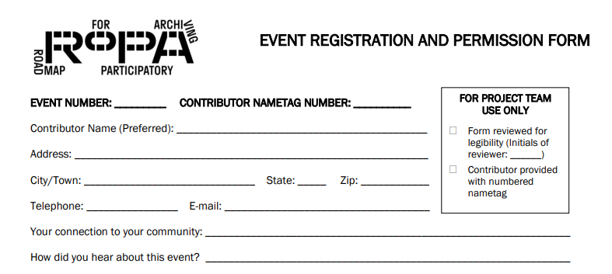
Event Registration and Permission Form
Notes:
Briefly walk Volunteers through the fields of the Event Registration and Permission Form.

Slide 9
Information Station
5-7 Volunteers for small events, 8-12 Volunteers for large events needed to:
Talk to Contributors about their Items and help them choose which ones to add to the collection
Help Contributors complete a Descriptive Information Form for each Item to be added to the collection
Volunteers should be:
Good listeners
Interested in hearing contributors’ stories
Able to ask questions to draw out additional details from Contributors
Notes:
Update the volunteer numbers based on the size of your event. The Information Station is where Contributors will complete the Descriptive Information Forms for the Items they plan to contribute to the collection. If your Project Team has decided on a limit of Items for Contributors, add that information on this slide. Each Item will require a separate Descriptive Information Form. This form is the Contributor’s opportunity to document their Items and share their story.

Slide 10
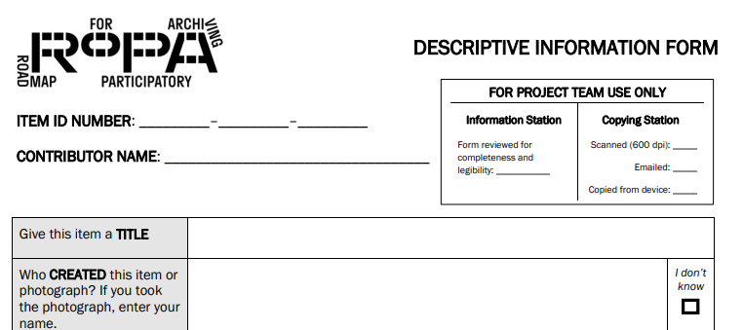
Descriptive Information Form
Notes:
Briefly walk Volunteers through the fields of the Descriptive Form.

Slide 11
Copying Station
4 Volunteers for small events, 6 Volunteers for medium events, 8 Volunteers for large events needed to:
Review and collect Descriptive Information Forms
Create digital copies of Contributor Items
Volunteers should be:
comfortable using a scanner, scanning software, cropping images, and renaming and saving files to a computer
detail-oriented
Notes:
Update the volunteer numbers based on the size of your event. The Copying Station is where Contributors’ Items are copied and the completed Descriptive Information Forms about those Items are reviewed and collected. Volunteers are needed in two different roles. One to make copies and one to review and collect the Descriptive Information Forms. The reviewer does not need to be familiar with technology.

Slide 12
Community Tables
Add your community specific information here.
Notes:
If your Project Team choose to include Community Tables, share information about the participating organizations and the planned activities on this slide. If you do not have Community Tables at your event, delete this slide.

Slide 13
RoPA Numbering System
1 - 12 - 1
Event Number
Contributor Number
Item Number
Item ID Number
Notes:
The Numbering System assigns every Item in the collection a unique Item ID Number.
This Item ID Number has of three parts: a pre-assigned event number (which at your event will be *fill in the number here*), followed by the Contributor’s event registration or nametag number that they get at the Welcome Station. The final part of the number is the particular Item that the Descriptive Information Form describes (1, 2, 3, etc.) assigned at the Information Station. The Copying Station will use the Item ID Number when naming and saving files.
Everyone working at the event will encounter this Numbering System and can help by making sure that all Contributors have their nametags displayed with the number showing.

Slide 14
Plans for the Collection
Add your collection-specific information here
Notes:
You’ll want Volunteers to know where (and approximately when) the collection will be available for Contributors. Share these details and any other plans for the collection on this slide.

Slide 15
Rank your station preferences
Write down your preferences for which Volunteer position you’d like.
1 is the station you feel is the best fit for you, 3 is the station you feel is less of a match.
Welcome Station
Information Station
Copying Station
Notes:
Give volunteers 5-10 minutes to rank their preferences, and then let everyone take a break.
During the break, the Community Coordinator, the Event Coordinator, and the Collection Coordinator will review preferences and make final assignments.
Bring the group back together briefly to split into station-specific training.

Slide 16
Station-Specific Trainings
Welcome Station
Led by Welcome Station Captain
Meeting in Room #
Information Station
Led by Information Station Captain
Meeting in Room #
Copying Station
Led by Copying Station Captain
Meeting in Room #
Notes:
Fill in your Station Captain Names and the Rooms (or areas of a larger room) where each station-specific training will take place. Once the station-specific trainings are complete, volunteers are free to go. You do not need to bring the group back together before ending.

